Slide 1
Brand Positioning I

Slide 2
Overview
Positioning defined
Components of a positioning statement
Points of difference/Points of parity
Positioning hierarchy

Slide 3
Positioning Defined…
“Positioning starts with a product…a service…a company…But positioning is not what you do to a product. Positioning is what you do to the mind of the prospect. That is, you position the product in the mind of the prospect.”
- Ries and Trout

Slide 4
What is a Harley-Davidson?
H-D CMO Mark-Hans Richer (2013):
“A Harley might have an engine, it might have wheels, and it might run on roads, but it’s not really about transportation; it’s not about getting from Point A to Point B. It’s about living life the way you choose…being free from the man.”

Slide 5
Positioning Statement
Should address these questions:
  Who is targeted for brand use?
  What goal does the brand help the consumer to achieve?
  Why should the brand be chosen over competitors?

Slide 6


Positioning Statement Examples
Body Shop:
“For people seeking wellness, the Body Shop offers the most natural bath and cosmetic products because we are the most environmentally friendly cosmetics company.”
Southwest Airlines:
“For short-route travelers, SWA offers the best prices with reasonable and dependable service because we operate point-to-point service and don’t charge more for last-minute bookings.”

Slide 7


Gatorade…Then and Now
Then: “For the serious-minded athlete, Gatorade, the original sports beverage, improves performance by rehydrating the body and replacing lost electrolytes.”
Now: “For athletes who are passionate about exercise, Gatorade is a sports nutrition product that helps athletes prime, perform, and recover before, during, and after exercise, because the Gatorade Sports Science Institute does more research on athletes than any other brand.”

Slide 8
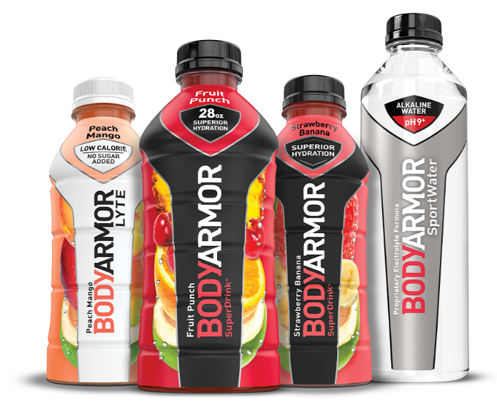
New Gatorade Challenger?
Coke acquires BODYARMOR
“…provides superior hydration. It is packed with electrolytes, coconut water and vitamins and is low in sodium and high in potassium…contains natural flavors and sweeteners and no colors from artificial sources.”

Slide 9
Points of Difference and Parity
POINTS OF PARITY: Features or benefits that are similar or identical to other competitors in the product category
POINTS OF DIFFERENCE: Unique (desirable) brand features or benefits that differentiate it from other competitors in the product category

Slide 10
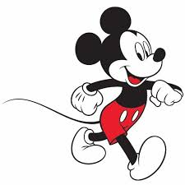
Brand Positioning Hierarchy
The higher a brand can move up the hierarchy to own higher value attributes in the consumer’s mind, the more difficult it will be for competitors to copy.
Personal Values
Psychological Benefits
Functional Benefits
Product Features
Concrete Product Offering
Notes:
23

Slide 11


Movin’ on up…

Slide 12
Conclusion
Does your company/brand have a clear positioning statement?
Is your positioning clearly distinct from competitors?

Slide 13
End of Lecture

